Slide 1
Reducing Commodity Costs
By Integrating Load Analytics:
Creating Demand Side Value by Leveraging Customer Data

Slide 2
Disclaimer. The views and opinions expressed by Viridity Energy are for informational purposes only. No reliance may be placed on such information and GDF SUEZ makes no representation as to accuracy, completeness, suitability, or validity of any information therein. In no event shall GDF SUEZ or its directors, principals, agents, employees or representatives be liable for any loss or damage whatsoever arising out of the use such information.

Slide 3



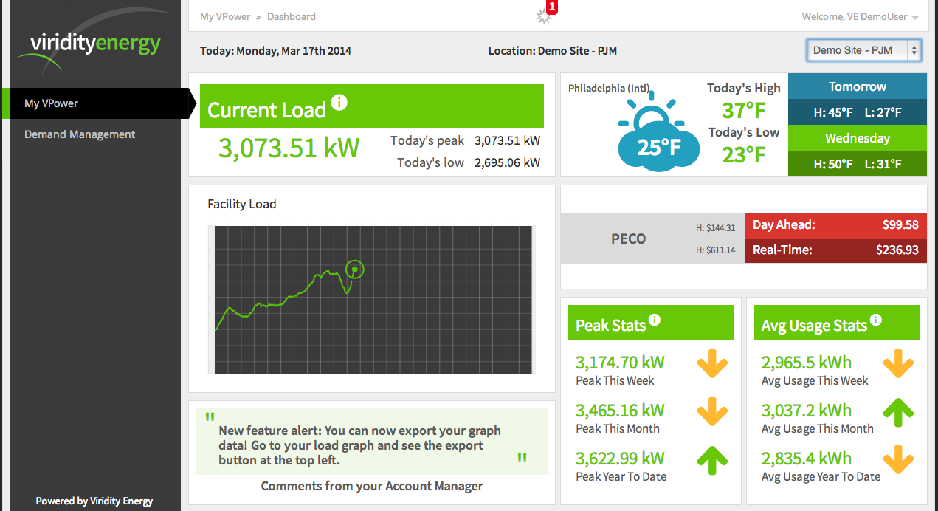

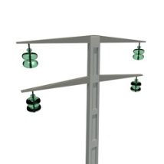







Viridity Energy Recognized Leader In Smart
Energy Technology
Key Company Facts
Founded in 2008 by leading grid management executives
Types of Clients
Experienced utility and power market executives
Technology innovators
Regulatory policy and affairs experts
Recipient of multiple industry awards and grants
Industrial
Military
Commercial
Unparalleled Solutions
Patented software platform
Provides energy consumers with predictive optimization software to optimize energy assets with energy market products and existing supply-side commitments and positions
Network Operating Center
supports customer participation in wholesale power markets and demand management strategies
Institutional
Campus
Utilities
Energy Markets Served: ERCOT (Texas) NYISO (New York) PJM (13 states covering mid-Atlantic region)
Viridity Energy Investors
Partnership with GDF SUEZ
Viridity’s partnership with GDF SUEZ creates demand and supply synergies that provide customers with holistic energy solutions
Notes:
3

Slide 4
The Smart Grid and You
Infrastructure Smart Grid
(ISO/utility)
Billions of dollars have been spent to create the Smart Grid
Enhance system reliability
Create accountability between usage and market value
Real Time Metering enables data collection
  Communication protocols and technology
The birth of BIG DATA
Handling BIG DATA
Ability to monitor load creates connection to price signals
Creating actionable solutions from Smart Grid investments
Demand Side Strategies
Supply Side Strategies
Individual Impact
Technology Enablement
Next Level Of Energy Spend Reduction
Access to load data
Identify load flexibility
Manage and control what you can control
Ability to respond to price signals
Vehicle for monetizing load flexibility in wholesale markets
Convergence of supply and demand planning and activities

Slide 5
The Energy Supply Chain Is Inefficient
Market
Commercial & Industrial customers represent $700B in energy assets
Typical utility model address peak supply needs
Fractured solutions markets, REPs, ESCO, UDC, Equip, Controls, etc.
Customer
Energy supply is critical to customers
Non-core to their business focus
Growing role of technology
Growing convergence in energy supply and demand
Split functions between supply procurement, sustainability/efficiency and operational considerations
Customers are asking for solutions
But
How confusing has it become?
“A picture tells a thousand logos….”

Slide 6
From a Customers Perspective
Source: Viridity Energy

Slide 7
Thoughts on Sorting It Out
Start with what your organization knows:
  Cost reduction targets
  Supply Procurement and commodity purchasing strategies
  Efficiency and sustainability objectives
  Your process and your assets
Recognize that the game is changing:
  Yesterday’s methods are not likely to deliver against tomorrow’s requirements
  New players
  New technologies
  New solutions
Find a well positioned, trusted partner who can deliver:
  New value opportunities that get you to your goals
  Knowledge transfer
  A commitment to understanding your business as a supply and services partner
Be willing to explore the art of the possible to determine how to use the new tools at your disposal

Slide 8
Utilizing Load Analytics
Accessing The Value

Slide 9
If You Have Accountability,
You Better Figure Out What You Can Control
Tool Box
Supply Side
Procurement Strategy
Products
Liquid wholesale market
Demand Side
Load analytics
Demand Response
Generation
Storage/renewables
Energy Efficiency Projects
Green credits
Incentives
Tax credits
Capital
Demand Side Strategy
Supply Side Strategy
Load
Price
ISO/Market
Two Variables Relating to Cost:
Load (what can you control?)
Price (what are your priorities?)

Slide 10
The Pieces
Supply Side Strategy
Competitive Procurement from deregulated market
Commoditization of physical supply
Forward price risk management through fixed pricing alternatives and financial hedging
Demand Side Strategy
Energy Efficiency Projects
Sustainability goals
Demand Response (“Free money”!!☺; BUT NO CONTROL☹)
Asset optimization
Why are we trying to manage these things separately????

Slide 11
Load Flexibility Creates Value
Reliability Programs
Low frequency , mandatory response
Easy to Implement
A reactive way to earn additional revenue stream
Economic Programs
High frequency, voluntary response program
Daily Price Settlement
A proactive way to earn additional revenue
Ancillary Programs
High frequency, high payment, short-notice program
Requires automated response due to short notice times and duration. Energy assets such as generators or battery storage can further enhance your ability to participate
Source: Viridity Energy

Slide 12
Traditional vs Dynamic Load Management
Traditional Demand Response
Customers cannot control when grid operators exercise the option
Customer obligated to commit in advance to curtail load by pre-determined amount
Dynamic Load Management
Customer load functions can operate automatically when so desired
Local utility monthly peak demand charges are considered and optimized against
Multiple electricity markets are considered to maximize energy spend reduction potential
Real time power price information used to optimize energy usage & participation in power markets
One source of revenue
Multiple sources of saving & revenue
Notes:
Customer obligated to commit in advance to curtail load by pre-determined amount

Slide 13
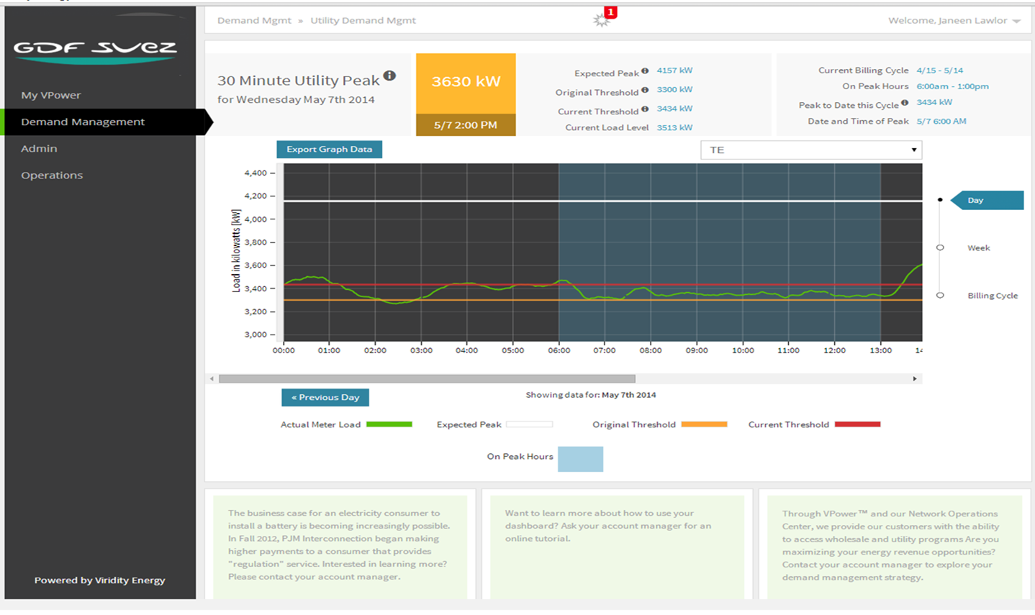
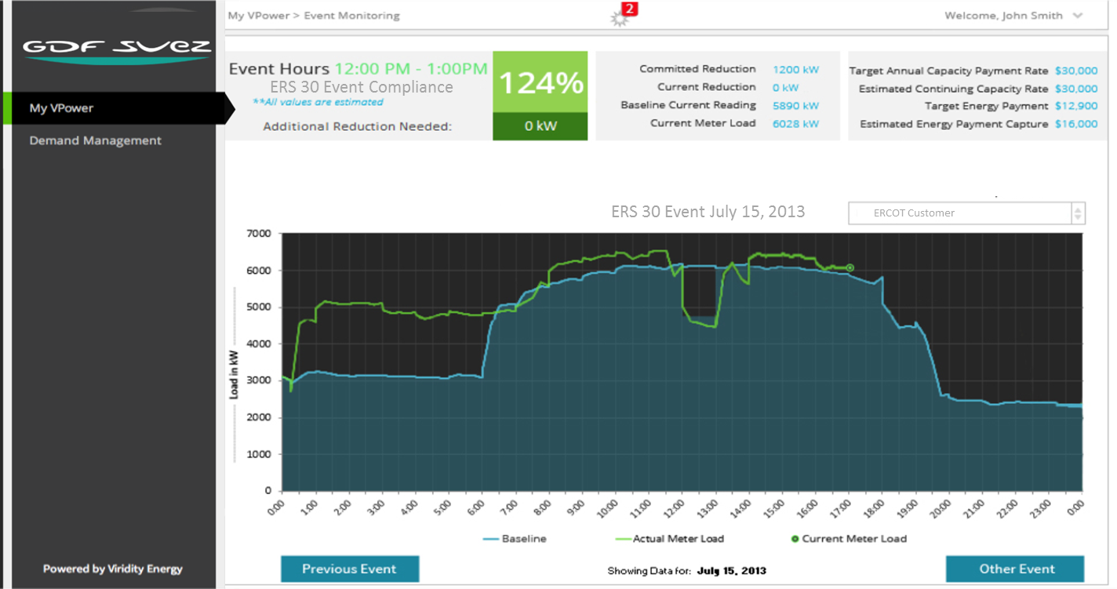
What Is The Opportunity?
  Dynamic linkage between the electric grid and large energy customers
  Enabling software that takes that linkage and turns customer energy profiles into financial returns
  Market execution and implementation services that leverages our software to deliver maximum financial results to our customers
An active demand management strategy
=
Reduced energy spend with no production impact
Voluntary energy market participation
=
New revenue from existing infrastructure

Slide 14
How Can You Participate in Load Management?
Capacity
Economic
Responsive Reserve Service
Regulation
Realize savings by shifting/shedding load during accurately predicted ISO peaks.
Participate in Advanced Demand Response
Manage Peak Load Contribution
Manage Monthly Utility Demand Peaks
Integrate supply contract planning
  Optimize the value of load flexibility into your supply purchasing strategy
Smooth monthly peaks on monthly utility bills through active load shifting/shedding

Slide 15






Curtailment Strategies: Asset vs. Process Management
 | Asset-Level Management | Process-Level Management
Definition | Select various assets that may be in multiple areas | Select entire lines within a single campus footprint
Application | Fast Response Load Shedding | Slow Response Load Shifting
Markets | UDM, Sync, Economic, Regulation | Capacity, 4CP/PLC, Economic
Control | Automated | Manual
Asset Selection | Developed jointly between customer and supplier
Dependent on | Market prices & production schedules

Slide 16
Value in Load Strategies
Depending on the market, and programs in place the following are guides for the value of one MW of retail load
PJM
~$50,000/MW/yr
* Varies by Region
$65,000/MW/yr
Utility Demand Management
ERCOT
$80,000/MW/yr
ERS-30
$40,000/MW/yr
Utility Demand Management
NEPOOL
$30,000/MW/yr
Capacity
$60,000/MW/yr
Utility Demand Management
$120k/MW/yr
Responsive Reserve Service
$52,000/MW/yr
Top 100 Hrs
$35,000/MW/yr
Synch RES
$35,000/MW/yr
Economic RT
$52,000/MW/yr
Synch RES
$31,000/MW/yr
Economic RT
Capacity
Demand
Ancillary Services
Energy
Source: Viridity Energy

Slide 17
Utilizing Load Analytics
Making It Work For YOU

Slide 18
What Does This Mean for Customers?
At a minimum; an engaged customer, managing daily energy needs, exercising load flexibility, using tools to handle large amounts of data, harvesting approx. $2.50-$6.00/MWh in cost reduction
Simple integrated solution
Monetized through customers monthly energy bill
Simple contract and settlement mechanism
Implementable within 2 months
Change in energy usage profile
As much as 20% reduction in monthly energy bill
  Lower energy price
  More flexibility
  Access to real time market
Little to no change in core competency (as measured in hours)

Slide 19
Bringing it All Together: An Integrated View
Convergence of Demand and Supply Side Strategies
  Use your commodity agreement (supply side strategy) to optimize the value of your ability to manage load (demand side strategy)
  Use load flexibility to benefit from market scarcity
  Use your position as a load resource to host the capital plays of others
  Use load flexibility and asset optimization to meet sustainability goals
  Optimize against your fixed price forward position
  Optimize hard assets like generation and storage using DR products AND market options
  Optimize soft assets like load reduction based on your constraints, not program requirements
  Examine all of the monetization options at your disposal
  Look at incentives and capital projects with accelerated returns based on the value of load flexibility that they create, not just operational efficiencies
Control Both of Your Key Variables by Having Them Work Together

Slide 20
Need More Specifics?
A couple of examples:
20MW total load with 4-6MW controllable load
2 NG generators with bad heat rates
Additional 6MW emergency permitted diesel generators
Historic load monetization value: $250,000 from DR
Estimated annual optimized load monetization value without material changes in operations: $600,000-$1.2M
Results based on applying a combination of ERCOT and utility based DR programs and market based structures that monetize load in RT and DA markets.
Combination commercial building and research lab with 4MW total load
300kw load reduction
1.5MW back up generator
Estimated annual optimized value of load monetization without material changes in operations: $200,000-$350,000

Slide 21
Great!! How??!!!
Each end user is different
Each answer is different for each end user
The common thread is the willingness to explore the art of the possible with the right team to help identify and navigate the options
GDF SUEZ brings the market tools
Viridity Energy distills the complexity into a business focus by showing you a simple value for each hour of each day of each month
  Is $2,000 enough to do something? Is $15,000 enough to do something else? You can now decide based on what is best for your business
Be willing to take control and provide yourself with the right tool box
GDF is already moving toward a broader solution orientation to help you get there, let them use their tools to find the right answer for your business

Slide 22
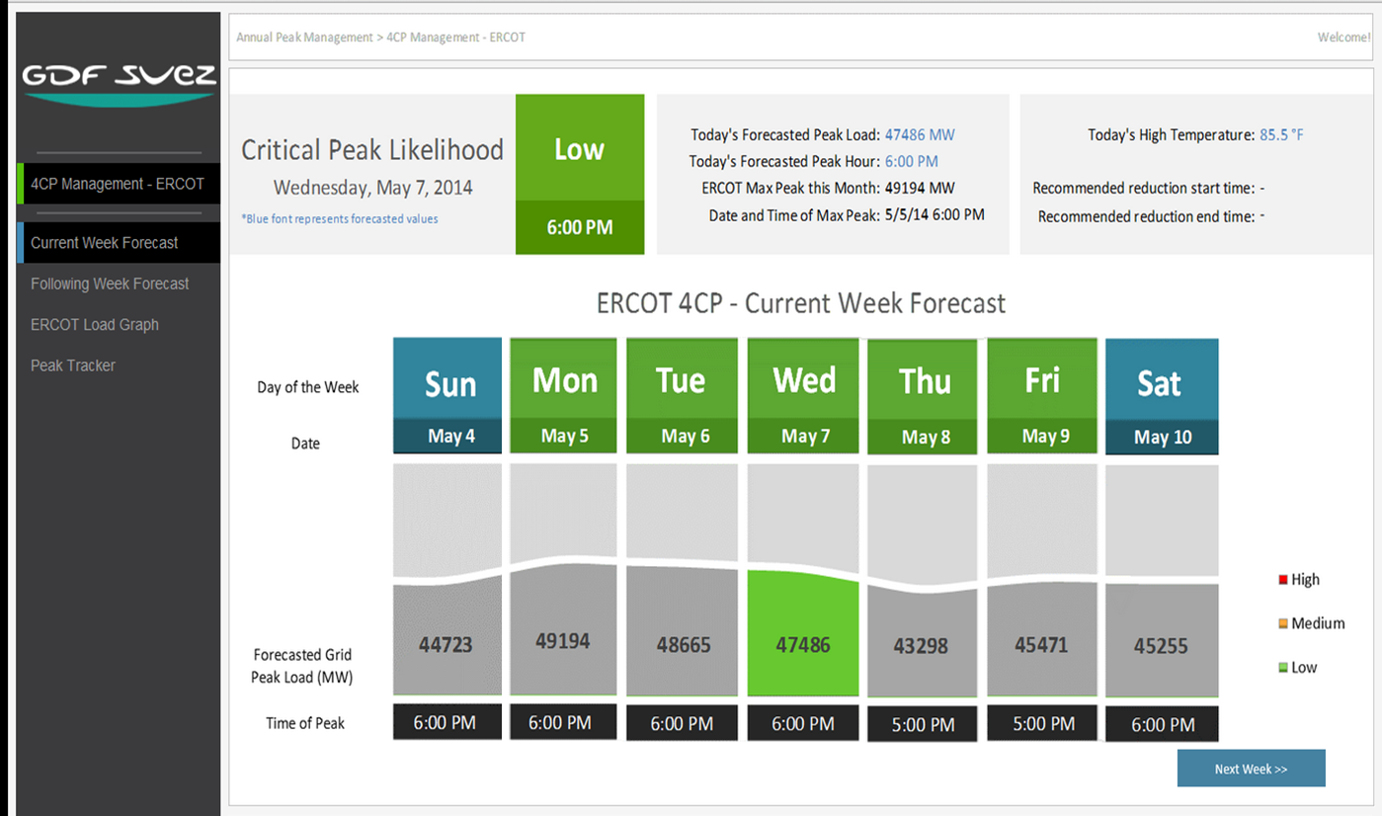
Annual Peak Management Service
Each day, customers can log into their current week forecast for insight into:
Critical peak likelihood (low, medium, high)
The recommended reduction start and end time (when applicable)
The day’s forecasted peak load
The day’s forecasted peak hour

Slide 23
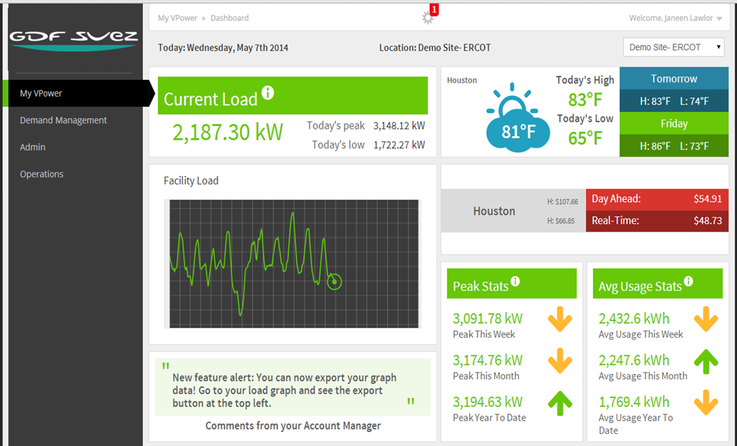
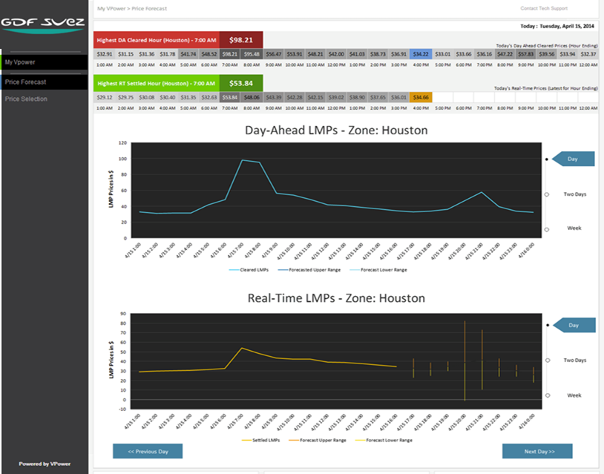
Manage, Execute, Validate Through Load Analytics
Energy Monitoring
Market Execution & Control
Key statistics help energy managers to closely monitor facilities and make proactive decisions about energy
Energy market programs enable customers to manage load in real-time, with the option for automated execution
Demand Management
Forecasting
Demand management allows proactive managements of peaks and save on utility bills
Price forecasting tool provides insight into market opportunities

Slide 24

Load Analytics Enables Insight, Action, Results
Enable Action
Manage demand, participate in programs
Utilize load, pricing and/or predicted conditions to determine best energy strategies
Optimize participation in energy markets with real-time monitoring, advisory and alerting
Implement auto-control and never miss an opportunity
Gain INSIGHT
Understand data and trends
View historical & forecasted energy profiles
Set customized alerts
Monitor real-time performance against plan
VPower™
Energy Visualization, Optimization, and Control
See Results
Achieve flawless execution and validation
Utilize on-call 24 hour NOC to manage and execute customer energy strategies
Use reporting to validate results
VPower™ offers advanced energy solutions to large energy customers

Slide 25

Questions and Answers

