Slide 1
2016 Annual Relationship, Marriage, and Divorce Survey
Final Report

Slide 2
The Study
These findings are based on a non-probability online sample of data collected using the Research Now panel. Data was collected in March 2016. A sample of over 2000 U.S. adults age 18 and over were surveyed online. For this poll, the credibility interval was calculated to be plus or minus 2.5 percentage points for all respondents. The data were weighted to the U.S. current population data by gender, age, and region based on Census data.
Avvo conducts periodic studies of topics at the intersection of lifestyle and the law to better understand the issues facing individuals engaging with attorneys and the legal system. Given that divorce and family law are two of the largest and most routine legal actions taken in the United States, understanding the relationship dynamics that lead to marriage and divorce is beneficial to the legal consumers and attorneys Avvo serves.

Slide 3
Contents
4 – Relationship Satisfaction
11 – Dating
19 – Fidelity
27 – Marriage
35 – Divorce
41 – The Cost of Relationships
46 – Same-sex Marriage
53 – Singles 50 and up
61 – About Avvo

Slide 4
Relationship Satisfaction

Slide 5
Relationships are good Most Americans are very satisfied in their relationships
How satisfied would you say you feel in your current relationship?
n=1411 people who are married or in a relationship

Slide 6
More women than men have something to complain about Men are more likely than women to be “very” rather than “somewhat” satisfied
How satisfied would you say you feel in your current relationship?
n=696 men and n=715 women who are married or in a relationship

Slide 7
Those who stick it out reap more rewards People over 55 are more likely to be “very” rather than “somewhat” satisfied
How satisfied would you say you feel in your current relationship?
n=385 18-34, n=556 35-54, and n=470 55+ who are married or in a relationship

Slide 8
More Republicans than Democrats have it great Republicans are more likely than Democrats to be “very” rather than “somewhat” satisfied
How satisfied would you say you feel in your current relationship?
How satisfied would you say you feel in your current relationship? n=416 Republican, n=515 Democrat, and n=290 Independent who are married or in a relationship

Slide 9
You might like your partner more if you go to church Those who identify with a formal religion (including Christianity, Judaism, Islam, and Buddhism) are more likely to be “very” rather than “somewhat” satisfied
How satisfied would you say you feel in your current relationship?
How satisfied would you say you feel in your current relationship? n=979 who identify w/ a relgion, n=97 who are spiritual, and n=137 who are agnostic/atheist who are married or in a relationship

Slide 10
Increase your chance at happiness in the South and Midwest Those in the South and Midwest are more likely to be “very” rather than “somewhat” satisfied
How satisfied would you say you feel in your current relationship?
n=293 Northeast, n=268 Midwest, n=508 South, n=342 West

Slide 11
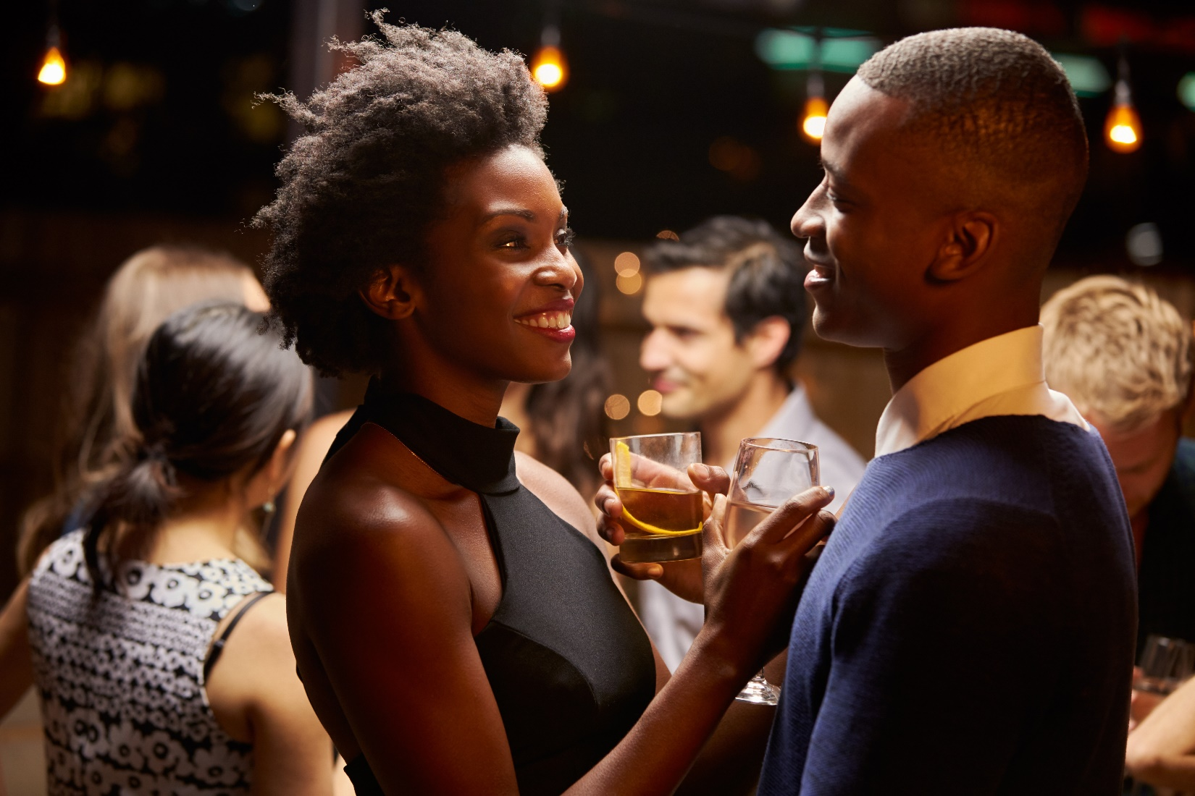
Dating

Slide 12
More single women than men are OK staying that way Half of single people aren’t dating; more women than men are not dating
Proportion of single people who are not actively dating
n=548 total single, n=269 single men, n=279 single women

Slide 13
More single men than women are looking for love online 3 in 10 single Americans have tried dating online; most have been men
Proportion of single people who have ever used an online dating site
n=548 total single, n=269 single men, n=279 single women

Slide 14
Most Americans don’t see potential in online dating Less than 1 in 5 of all Americans believe online dating is a great way to meet someone
Say online dating is an excellent way to meet a romantic partner
n=2000; n=984 men, n=1016 women

Slide 15
The online dating experience isn’t impressing most people Only one in five have had a lot of success with online dating
Proportion of online daters who’ve had a lot of success with it
n=385 total, n=223 men, n=162 women who have ever used an online dating site

Slide 16
But online dating is working for some Half of those in relationships who have ever dated online have found their current partner that way
Proportion of all people currently in a relationship who met their current partner online
Proportion of online daters currently in a relationship who met their current partner online
n=1,452 people in a relationship or married; n=230 people in a relationship or married who have tried an online dating site

Slide 17
Still, many prefer a face-to-face romantic spark Half of all American men and women think a face-to-face meeting is the best way to start a relationship
Believe the best way to meet a potential partner is face-to-face
n=2000; n=984 men, n=1016 women

Slide 18
Americans feel they need professional help finding love About 30% of men and women are open to the idea of getting the help of a relationship expert
Say that, as a single person, they’d be willing to have a professional relationship expert match them with a romantic partner
n=2000; n=984 men, n=1016 women (T3B)

Slide 19
Fidelity

Slide 20
More men than women stray About 1 in 4 men have ever cheated in a relationship
Have ever had sex with someone outside of their relationship without the approval of their partner
n=1912 people, n=923 men, n=989 women who have ever been in a relationship

Slide 21
Few Americans have open relationships Only 4% have ever agreed to have an open relationship with their partner
Entered an agreement with their partner that allowed them to have sex with other people
n=1912 people, n=923 men, n=989 women who have ever been in a relationship

Slide 22
More women are morally opposed to “being open” A little over half of all Americans are morally opposed to open relationships; the rest feel neutral about or comfortable with it
Morally opposed to the idea of open relationships
n=2000; n=984 men, n=1016 women

Slide 23
Fewer men reject a partner’s request to “be open” A little over half of all Americans would leave a partner who wanted to be “open”; the rest would not see such a request as an automatic deal-breaker
Say that if their romantic partner wanted an open relationship, they would leave them
n=2000; n=984 men, n=1016 women

Slide 24
Southerners, Midwesterners aren’t as morally “open” More Americans living in the Northeast and West are morally neutral or OK with open relationships
Are morally opposed to the idea of open relationships
n=451 Northeast, n=388 Midwest, n=700 South, n=461 West

Slide 25
Fewer Northeasterners would leave if asked for “openness” Fewer Southerners are tolerant of a request for an open relationship by their partner
Say that if their romantic partner wanted an open relationship, they would leave them
n=451 Northeast, n=388 Midwest, n=700 South, n=461 West

Slide 26
Fewer men reject the idea of dating a married person Half of all Americans – and more women than men – say that, if single, they’d stay away from dating someone who is married
Would never, as a single person, date someone who is married
n=2000; n=984 men, n=1016 women

Slide 27
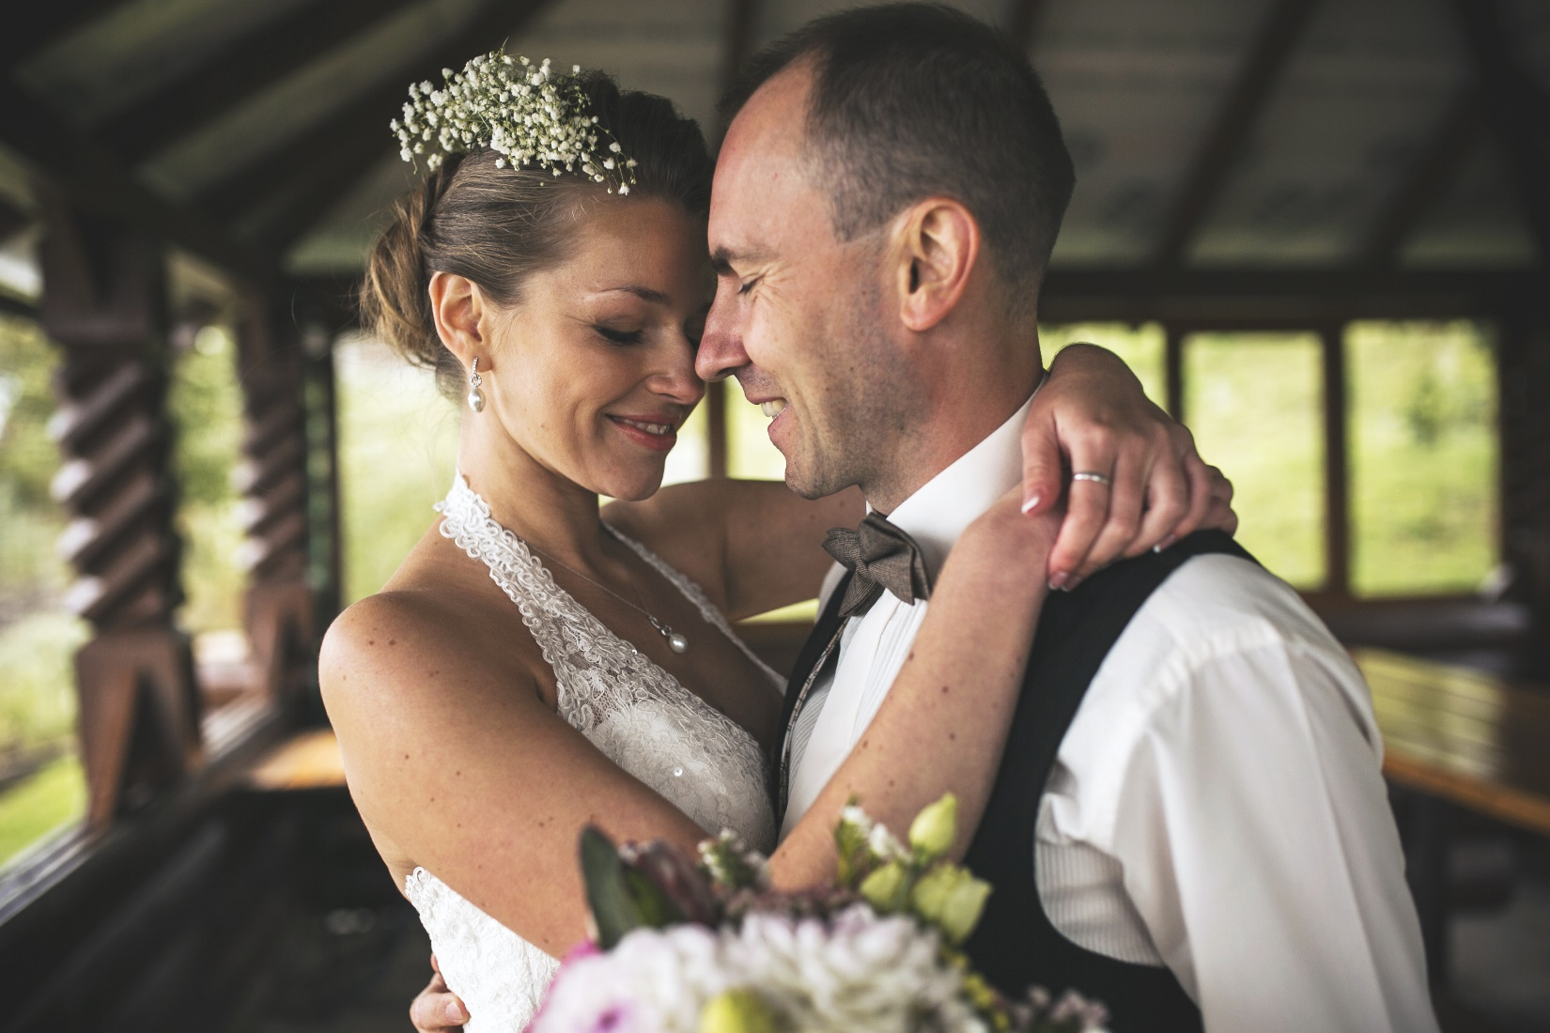
Marriage

Slide 28
Relationship longevity is something Americans believe in Most people, and especially women, believe relationships should last
Believe relationships were meant to last
n=2000; n=984 men, n=1016 women

Slide 29
Most Americans believe in the institution of marriage More women than men say marriage isn’t an outdated institution
Don’t think marriage is an outdated institution
n=2000; n=984 men, n=1016 women

Slide 30
However, less than a quarter see marriage as a life goal Only 1 in 5 Americans say marriage is something everyone should aspire to do
Think marriage should be a goal everyone has in life
n=2000; n=984 men, n=1016 women

Slide 31
Getting a prenup is hardly a popular practice Only 2% of Americans have ever had one
Proportion of married Americans who have ever gotten a prenup
n=1,345 people who have ever been married

Slide 32
There is an interest in prenups as a source of protection About 1/5 Americans say prenups are necessary
Think prenups are necessary to protect yourself in a marriage
n=2000; n=984 men, n=1016 women

Slide 33
And prenups aren’t a romance-killer for a lot of people Most say they’d remain romantically secure or feel unaffected if they were asked for a prenup
Say they would doubt their partner’s feelings for them if their partner asked for a prenup
n=2000; n=984 men, n=1016 women

Slide 34
Marriage is more frequent for some Americans 1 in 20 get married three or more times
Proportion of married or divorced Americans who have been married more than twice
n=1,345 people, n=627 men, n=718 women who have ever been married

Slide 35
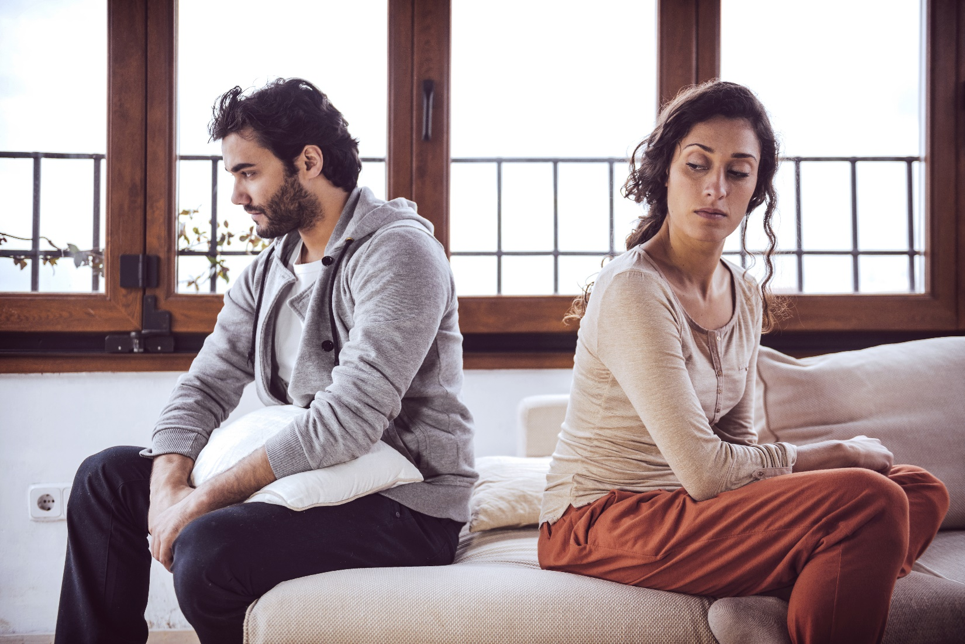
Divorce

Slide 36
Most Americans blame their exes for the failure of their marriage More women than men are passing the blame, and more men are willing to share it
Whose fault was your divorce?
n=460 total divorced, 206 divorced men, 254 divorced women

Slide 37
Most who divorce don’t look back For 3 out of 4 women, and also for most men, divorce does not come with regret
Don’t regret being divorced
n=460 total divorced, 206 divorced men, 254 divorced women

Slide 38
This could be because, for most, happiness trumps being attached Most say they’d rather be alone if being with someone brings less happiness
Would rather be alone, successful, and happy than in a relationship where they’re not happy
n=2000; n=984 men, n=1016 women

Slide 39
But losing that loving feeling is not enough of a reason to split Only 1 in 4 think that no longer wanting romance with your spouse is a reason to get a divorce
Believe that married couples who no longer want to be in a romantic relationship should definitely get a formal divorce
n=2000; n=984 men, n=1016 women

Slide 40
Moral beliefs around divorce may not be enough to prevent it Only 1 in 10 believe divorce is a sin.
Divorce is a sin
n=2000; n=984 men, n=1016 women

Slide 41
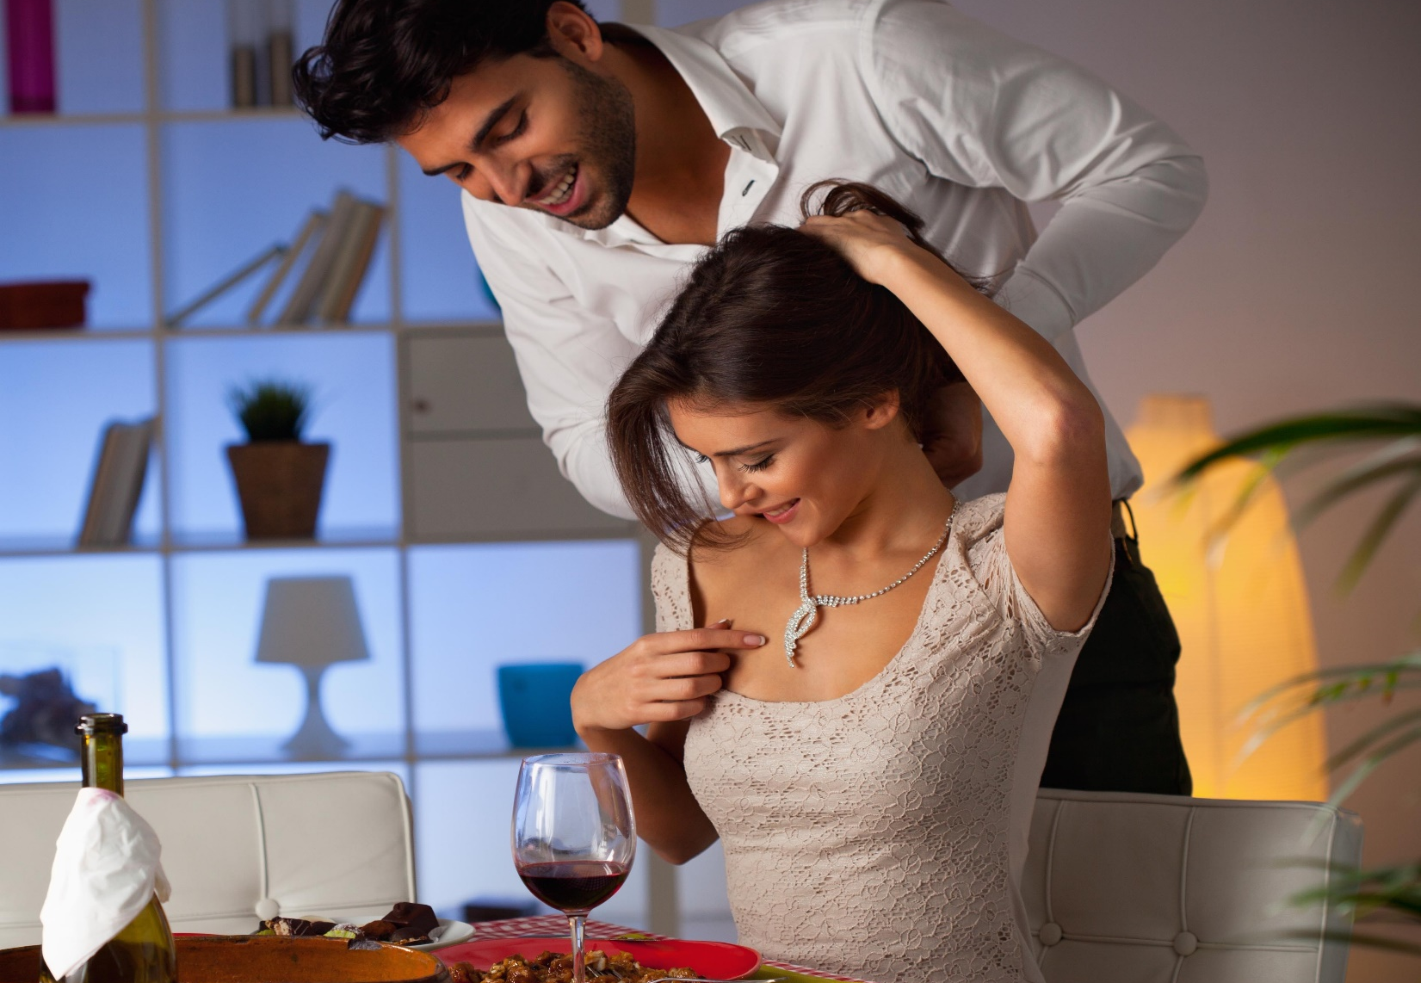
The Cost of Relationships

Slide 42
Most Americans believe time makes a relationship work A large majority say that what you get out of a relationship depends on the time you put into it
Believe that what you get out of a relationship is related to how much time you put into it
n=2000; n=984 men, n=1016 women (T3B)

Slide 43
Money isn’t as important, but it’s more important for men More men than women say that a good relationship has to do with what you spend on it
Believe that what you get out of a relationship is related to how much money you put into it
n=2000; n=984 men, n=1016 women (T3B)

Slide 44
For most, saving money isn’t a reason to stick around Only 14% say they’ve ever stayed with someone for financial reasons
Stayed in a relationship longer than they wanted to because it was affordable
n=1912 people, n=923 men, n=989 women who have ever been in a relationship

Slide 45
Most don’t care about sunk costs either Less than 10% stuck around in a relationship because they’d already spent a lot on it
Stayed in a relationship longer than they wanted to because they put a lot of money into it
n=1912 people, n=923 men, n=989 women who have ever been in a relationship

Slide 46
Same-sex Marriage

Slide 47
Attitudes regarding same-sex marriage may be changing One year after the SCOTUS ruling, more Americans may be accepting same-sex marriage in a legal sense
Believe same-sex marriage should be legal
2015: n=2011
2016: n=2000

Slide 48
Men’s attitudes about same-sex marriage have shifted more While the proportion of female supporters has stayed the same, more men this year support it than did before the SCOTUS ruling
Men believing same-sex marriage should be legal
Women believing same-sex marriage should be legal
2015: n=903 men, n=1108 women
2016: n=984 men, n=1016 women

Slide 49
Attitudes among older Americans have also seen an shift More Americans over 55 support same-sex marriage a year after the SCOTUS ruling than did before
Americans 55+ believing same-sex marriage should be legal
2015: n=720 55 and older
2016: n=665 55 and older

Slide 50
Regionally, attitudinal shifts are greatest in the Northeast Northeasterners and Midwesterners have become more comfortable with the legalization of same-sex marriage
Northeasterners that believe same-sex marriage should be legal
Midwesterners that believe same-sex marriage should be legal
2015: n=366 Northeast, n=474 Midwest
2016: n=451 Northeast, n=388 Midwest

Slide 51
Attitudes in the South and West haven’t really shifted There’s no statistically significant difference among Southerners and Westerners from 2015 to 2016
Southerners that believe same-sex marriage should be legal
Westerners that believe same-sex marriage should be legal
2015: n=700 South, n=471 West
2016: n=700 South, n=461 West

Slide 52
More Democrats have changed their position on the issue Republicans are still largely unsupportive of same-sex marriage, but support among Democrats has increased
Democrats believing same-sex marriage should be legal
Republicans believing same-sex marriage should be legal
2015: n=649 Democrats, n=556 Republicans
2016: n=744 Democrats, n=544 Republicans

Slide 53
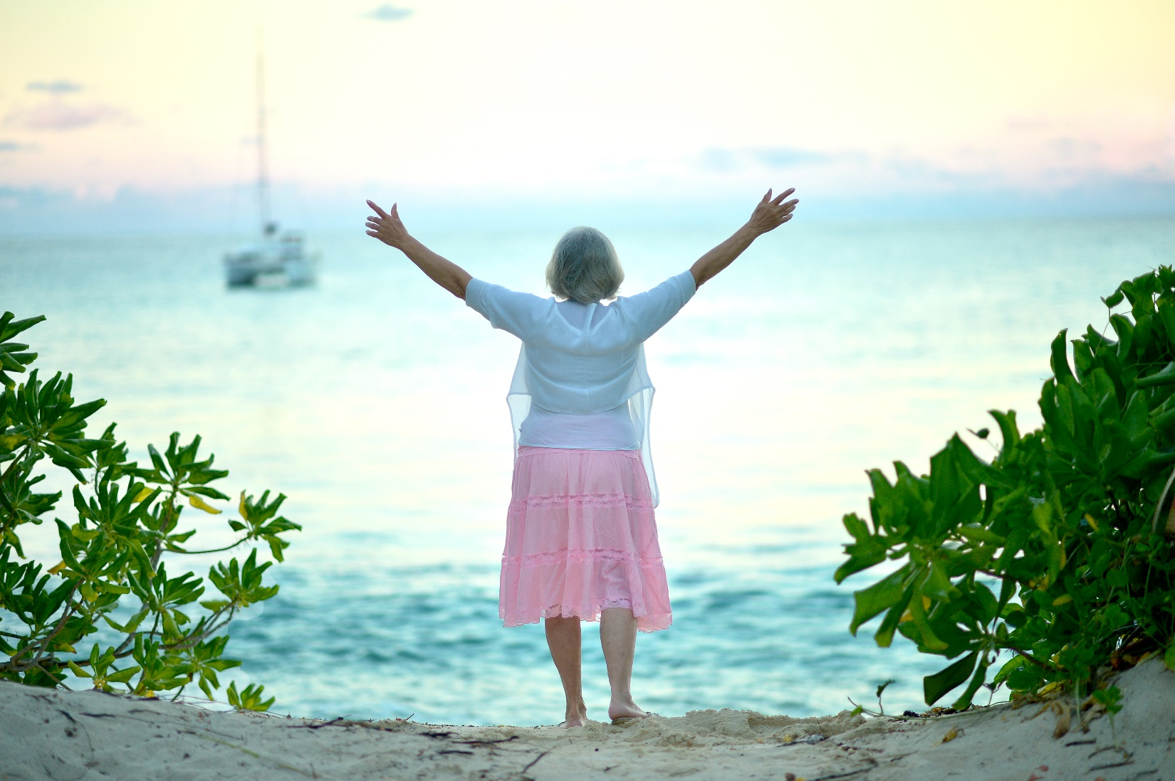
Singles 50 and up

Slide 54
Many older singles have bypassed marriage 1 in 3 singles 50 and up have never been married
Relationship Statuses of Singles 50 and up
n=217 singles 50 and older

Slide 55
Most don’t seem interested in romance Only a little over a quarter are currently looking for a partner
Singles 50 and up who are currently dating/looking for a romantic partner
28%
n=217 singles 50 and older

Slide 56
Most older singles prefer happiness over companionship A large majority say they’d rather be happy and alone than with someone
Singles 50 and up who say they’d rather be alone, successful, and happy than in a relationship where they aren’t happy
84%
n=217 singles 50 and older

Slide 57
If they were to date, half would want to meet someone in person Half agree with the notion that meeting someone face-to-face is the best way to start a romance
Singles 50 and up who believe meeting someone face-to-face is the best way to first meet a romantic partner
51%
n=217 singles 50 and older

Slide 58
Online dating hasn’t caught on with most singles 50 and up Only about 1 in 5 have ever tried it, and 1 in 10 think it’s a good idea
Singles 50 and up who...
Have used an online dating site at some point
Say online dating is an excellent way to meet a romantic partner
n=217 singles 50 and older

Slide 59
Older singles may try professional matchmaking About 1 in 4 say they’d give a professional relationship expert a shot
Singles 50 and up who are willing to have a professional relationship expert match them with a partner
26%
n=217 singles 50 and older (T3B)

Slide 60
Older singles are likely to be monogamous Very few have been in an open relationship, and about 3 in 10 seem neutral or open to the idea
Singles 50 and up who…
n=217 singles 50 and older

Slide 61
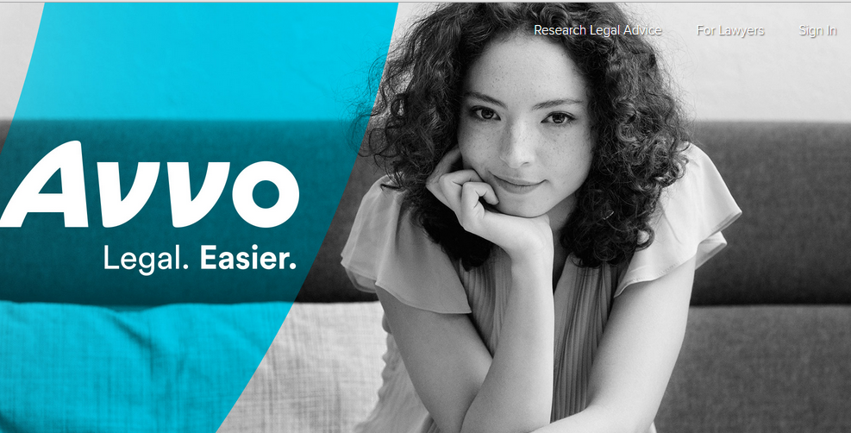
About Avvo

Slide 62
About Avvo
Avvo has the country’s largest and most reliable online attorney directory. Avvo lawyers answer questions about divorce, prenuptial agreements, and family law in the company’s Q&A forum everyday and are featured in the Avvo directory, which includes profiles on 97% of licensed attorneys in the United States. Attorneys are also available to answer on-demand questions about divorce through Avvo Advisor, which provides 15-minutes of legal counsel from a qualified attorney in your state for $39.
For additional resources about marriage and divorce from Avvo, or to find a divorce or family lawyer in your area, visit www.avvo.com.

Slide 63
Thank you!
Nika Kabiri, Director of Avvo Consumer Insights
nkabiri@avvo.com

